Slide 1
Computation Theory
Chapter 2
Limits of Deterministic Finite Automaton (DFA)
Non Deterministic Finite Automaton (NDFA)
Dr.Tarek Althami College of Science & Computer Engineering, Yanbu 2012-2013
Limits of DFA & NDFA

Slide 2
Regular languages
A language L over the alphabet Σ is regular iff (if and only if) there is a Deterministic Finite Automaton that accepts L.
Limits of DFA & NDFA

Slide 3
Regular languages
Show that the language
L = {awa : w ∈ {a,b}*}
is regular.
To do this, all we have to do is construct a DFA that accepts this language
Limits of DFA & NDFA

Slide 4
L = {awa : w ∈ {a,b}*}
a
a
q₀
q₁
q₂
b
a,b
q₃
This finite accepter accepts all and only the strings of the language given above. But note that there are two arcs out of q₁ labeled a. How does the FA know which path to take on an a? It doesn’t; it has to magically guess right. Also, there are no arcs out of q₂. So this FA is nondeterministic.
Limits of DFA & NDFA

Slide 5
Nondeterminism
A finite automaton is deterministic if:
from every node there is exactly one arc labeled for each character in the alphabet of the language
Limits of DFA & NDFA

Slide 6
L = {awa : w ∈ {a,b}*}
b
a
q₀
q₁
q₂
a
b
b
a
q₃
a,b
This is a deterministic version of the previous automaton; there is exactly one arc out of each state labeled with each symbol from Σ.
Limits of DFA & NDFA

Slide 7
Nondeterministic finite accepters
Actually, any nondeterministic FA can be turned into a deterministic FA. That is why this class of automata is called Deterministic Finite Accepters.
Limits of DFA & NDFA

Slide 8
Deterministic finite accepters
L = {a^{m}b^{n} : m, n ≥ 0}
Give a DFA that accepts this language
Limits of DFA & NDFA

Slide 9
L = {a^{m}b^{n} : m, n ≥ 0}
What do we know about this language’s automaton?
Will it accept the empty string? If so, how do we represent that?
Will it accept strings that begin with an a?
Having begun with an a, seeing indefinitely many more a’s are OK ; the automaton can loop here.
Will it accept strings that begin with a b?
Once it sees a b, the automaton now has to be on guard.
As long as it continues to see b’s , it’s OK; loop.
If the string ends here, accept.
If it sees an a after seeing a b, reject.
Limits of DFA & NDFA

Slide 10
L = {a^{m}b^{n} : m, n ≥ 0}
a
b
a
q₀
q₁
q₂
q₃
b
a
b
q₄
Does this automaton correspond to (represent, accept) the above language?
(Be careful!)
Limits of DFA & NDFA

Slide 11
L = {a^{m}b^{n} : m, n ≥ 0}
a
b
a
q₀
q₁
q₂
b
a,b
Does this automaton correspond to (represent, accept) the above language? Is it deterministic?
Limits of DFA & NDFA

Slide 12
Some exercises
a
b
a,b
b
a
q₀
q₁
q₂
Use set notation to describe the language accepted by the above DFA
Limits of DFA & NDFA

Slide 13
Some exercises
a
b
a,b
b
a
q₀
q₁
q₂
L(M) = {a^{n}b^{m}}, where n ≥ 0 and m ≥ 1
Limits of DFA & NDFA

Slide 14

Limits of DFA
Theorem
For any alphabet , there exists a language that cannot be recognized by any finite automaton (the set of languages ​​is much larger than the one of automata)
Example 1
The language consisting of all palindromes over the alphabet , cannot be accepted by any DFA. Therefore it is not a regular language. If we take the alphabet = {a, b}, some examples of palindromes are :
{a, b, aa, bb, aaa, aba, . . .}
Limits of DFA & NDFA

Slide 15
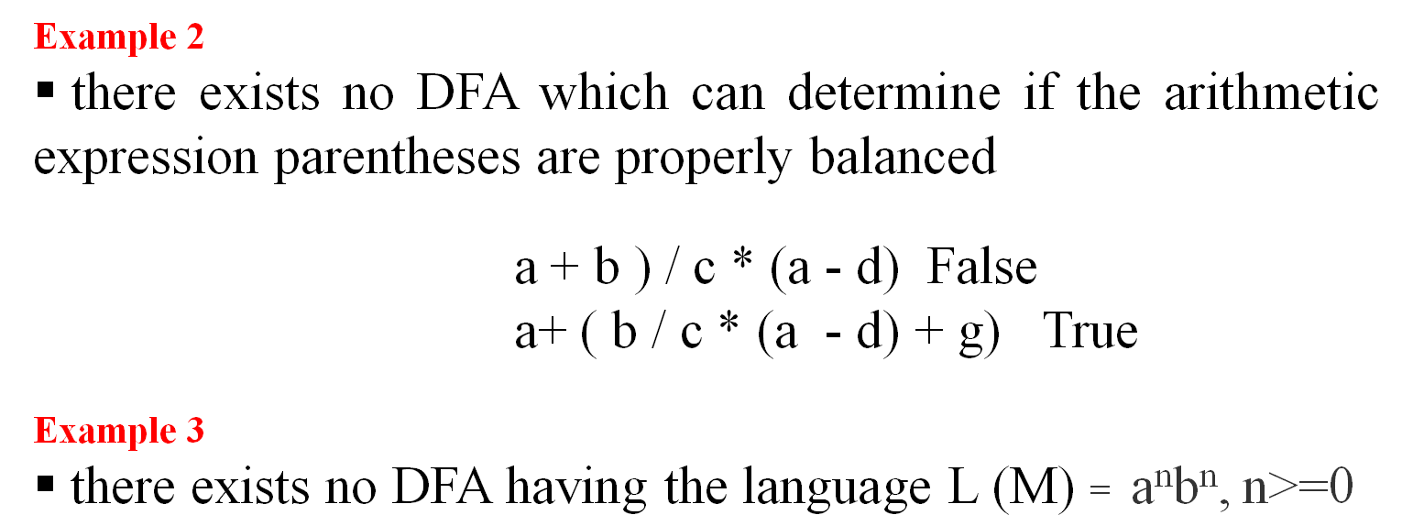
Limits of DFA
Limits of DFA & NDFA

Slide 16
NDFA
An NDFA can be non-deterministic by:
having more than one edge with the same label originate from one vertex: see state q₁, which has two arcs labeled 0 emanating from it
having states without an edge originating from it for some symbol: see state q₂, which has no edges labeled 0 or 1. (This may be interpreted as a transition to the empty set.)
having lambda-transitions: see state q₀, which has an arc indicating that a λ-move from q₀ to q₂ is possible
1
0,1
q₀
q₁
q₂
0
λ
Limits of DFA & NDFA

Slide 17
NDFA
A non-deterministic finite accepter (abbreviated NFA or NDFA) is defined by the quintuple : M = (Q, Σ, δ, q₀, F)
  Q is a finite, nonempty set of states
  Σ is finite set of input symbols called alphabet
  δ: Q × (Σ ∪ {λ}) → 2^{Q} is the transition function
  q₀ ∈ Q is the initial state
  F ⊆ Q is a set of final or “accepting” states
Limits of DFA & NDFA

Slide 18
NDFA
Differences between a DFA and an NDFA:
(1) in an NDFA, the range of δ is in the powerset of Q (instead of just Q), so that from the current state, upon reading a symbol:
(a) more than one state might be the next state of the NDFA
(b) no state may be defined as the next state of the NDFA
(2) λ-moves are possible; that is, a transition from one state to another may occur without reading a symbol from the input string.
Limits of DFA & NDFA

Slide 19
NDFA
The extended transition function for an NDFA is defined so that δ* (q_{i}, w) contains q_{j} iff there is a walk in the transition graph from q_{i} to q_{j} labeled w.
The language L accepted by an NDFA
M = (Q, Σ, δ, q₀, F) is defined as
L(M) = {w ∈ Σ* : δ* (q₀, w) ∩ F ≠ ∅}
That is, the language consists of all strings w for which there is a walk labeled w from the start state to a final state in the transition graph.
Limits of DFA & NDFA

Slide 20
NDFA = DFA
One kind of automaton is more powerful than another if it can accept and reject some kinds of languages that the other cannot.
Two finite accepters are equivalent if both accept the same language, that is,
L(M₁) = L(M₂)
As mentioned previously, we can always find an equivalent DFA for any given NDFA. Therefore, NDFA’s are no more powerful than DFA’s.
Limits of DFA & NDFA

Slide 21
NDFA → DFA
Theorem
Let L be the language accepted by a non-deterministic finite accepter M_{N} = (Q_{N}, Σ, δ_{N}, q₀, F_{N}) . Then there exists a deterministic finite accepter M_{D} = (Q_{D}, Σ, δ_{D}, q₀, F_{D}) such that L = L(M_{D}).
.
Limits of DFA & NDFA

Slide 22
NDFA → DFA
Convert the following NDFA into an equivalent DFA
      Q = {1, 2, 3}
      Σ={a, b}
      δ= {(1, b, 2) (1, b, 3) (3, a, 1) (3, a, 2)}
      q₀= {1}
      F= {3}
The state transition diagram is :
3
a
1
b
a
b
2
Limits of DFA & NDFA

Slide 23
NDFA → DFA
  The new transition function δ: Q × (Σ ∪ {λ}) → 2^{Q}
  Our new DFA will have a state labeled ∅
  construction of the new DFA is based on the following results:
  Q’ = P(Q)={∅, {1}, {2}, {3}, {1, 2}, {1, 3}, {2, 3}, {1, 2, 3}}
  Σ={a, b}
  q₀= q₀’={1}
  F= {{3}, {1, 3}, {2, 3}, {1, 2, 3}}
    δ (∅, a) = ∅ δ (∅, b) = ∅
    δ ({1}, a) = ∅ δ ({1}, b) = {2, 3}
    δ ({2}, a) = ∅ δ ({2}, b) = ∅
    δ ({3}, a) = {1, 2} δ ({3},b) = ∅
    δ ({1, 2}, a) = ∅ δ ({1, 2}, b) = {2, 3}
    δ ({1, 3}, a) = {1, 2} δ ({1, 3}, b) = {2, 3}
    δ ({2, 3}, a) = {1, 2} δ ({2, 3}, b) = ∅
    δ ({1, 2, 3}, a) = {1, 2} δ ({1, 2, 3}, b) = {2, 3}
3
a
1
b
a
b
2
Limits of DFA & NDFA

Slide 24
NDFA → DFA
a
b
{2}
a
{∅}
b
{3}
b
a
a
a
b
a
If we eliminate the states which can not be achieved, we obtain the following DFA
{1}
b
{2,3}
{1, 2}
b
a
b
b
a
b
a
{∅}
{1,3}
{1,2,3}
a
a
b
a
{1}
b
{2,3}
{1, 2}
It is easier to see that the language the automaton accepts is
L(M)={b (a b)^{n} / n ∈ N }
b
Limits of DFA & NDFA

Slide 25
Conclusion
Finite automaton can recognize in a program key words, identifiers and numbers, but not arithmetic expressions parentheses and Begin-End blocks. In the next chapters we will define more powerful machines to recognize a wider range of languages.
Limits of DFA & NDFA

